Slide 1
HOW WE EXPRESS OURSELVES. gRADE 5 ISS. CONFLICT.
In any artwork the artist is expressing themselves emotionally although not directly. Our understanding of what the artist is trying to express, through looking at cultural context etc., deepens our response to the work

Slide 2
PHOTOGRAPH OF THE HAZE INDONESIA

Slide 3
Painting about the potato famine in Ireland

Slide 4
CRIMEAN WAR

Slide 5
SYRIA CONFLICT

Slide 6
GUERNICA BY PABLO PICASSO. What is this painting telling us?

Slide 7
LS LOWRY. Would you like to live here?

Slide 8
VAN GOGH SELF PORTRAIT. What does he feel like in this painting?

Slide 9
Edvard Munch. Why do you think he has chosen this subject for his artwork?

Slide 10
The Scream by Eduard Munch.
Here the artist uses color to reflect inner conflict and unhappiness .

Slide 13
BULLYING STOPS HERE!

Slide 14
.
This painting is by Pablo Picasso in his Blue period. Entitled The Tragedy. He uses the color blue to reflect sadness and loss

Slide 15
L. S Lowrey was a painter from the north of England. His colors are subdued and grey reflecting the difficult lives people endured as they experienced the industrial revolution.

Slide 16
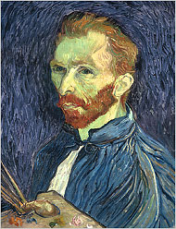
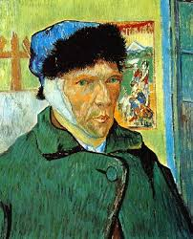
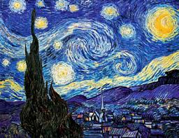
Vincent Van Gogh.
His use of color and dramatic brushstrokes were an expression of inner emotional conflicts.

Slide 17
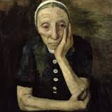
Modern portraiture.
Modern artists changed the way we viewed images of people. Artists who were part of the Expressionism art movement wanted to convey emotion through color.

Slide 18
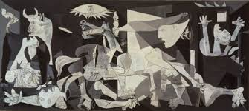
War has been an inspiration to many artists. This painting in Cubist style was created by Pablo Picasso and depicts the horrors of the Spanish civil war.
Although it is abstract you can probably recognize some of the images.
The painting is called Guernica the name of a Spanish town that was completely destroyed in the war.

Slide 19
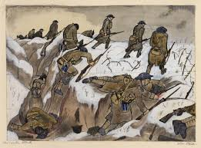
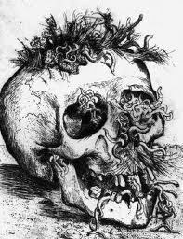
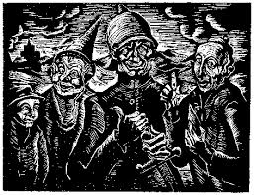

Slide 20
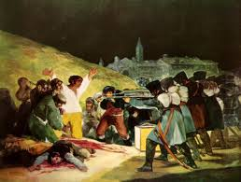

Slide 21
This is a self portrait of Frida Kalho a famous Mexican artist who suffered a traffic accident as a young girl.

Slide 22
She had many operations and suffered from a lot of pain. Her artwork expresses the impact the accident had. What images does she use in this self portrait?

Slide 23
These miners boots were painted by Van Gogh.
What do they represent? Why did Van Gogh express a feeling through an object?
To interpret an artwork may require some understanding of the artist’s life, and the circumstances in which the artwork was created.

Slide 24
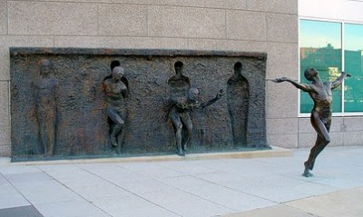
Art can be such a powerful and emotional mode of communication.
The artist is Zenos Frudakis.
The piece is located at the GlaxoSmithKline headquarters in Philadelphia.

Slide 25
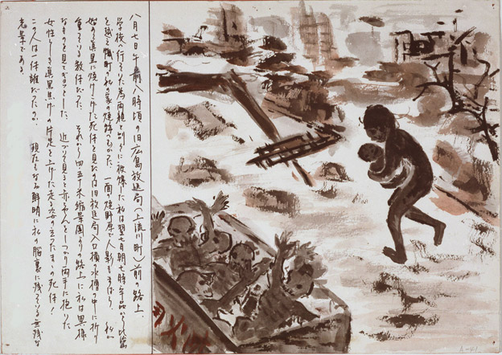

Slide 26
Mary Magdalene by Donatello (1454-55), white poplar wood. This polychromed wood sculpture is one of the most expressive of Donatello's works. The emaciated, hollow-eyed, almost toothless figure seems to embody dramatically a mood that was only to surface at the end of the century in Florence under the spell of Savonarola. It is a radical departure from the classical models of his earlier work. Duomo Museum, Italy

Slide 27
What is the artist trying to express in this sculpture?

Slide 28
The bombing of Hiroshima 1945 Between 60,000 and 80,000 people were killed instantly when the bomb was dropped in 1945. Many more died of the long-term effects of radiation sickness and the final death toll was calculated at 135,000.
The Sensory War exhibition explores "how artists have communicated the impact of war on the body, mind, environment and human senses" since World War One, according to the gallery.

